Slide 1
Topic Modelling

Slide 2
Topic Modelling
An unsupervised method that is widely used to automatically discover underlying topics/themes from a set of text documents
Assumes that documents are mixtures of topics, and topics are mixtures of words
Topics (unobserved/latent variables) are identified from words & documents (observed variables) using probabilistic generative models
Implemented using Latent Dirichlet Allocation (LDA) technique

Slide 3
Multi-nominal distribution
Documents are represented as random mixtures over latent topics
Each document can be labelled with multiple topics, which also resembles real time scenario
For example a document can discuss 60% about politics and 40% about technology
Documents are assumed to be sampled from Dirichlet Distribution with certain hyper parameters
Likewise topics are assumed to be random mixtures of words, which can also be sampled from Dirichlet Distribution

Slide 4
Advantages
Document can be tagged with multiple topics
This contrast with the other classification techniques, which assumes one class(topic) per document
Same word can appear in multiple topics, with different context
This solves the problem of polysemy, which is not possible with LSA
For example the context of the word “bank” can be different in finance documents and it means completely different while discussing river bank

Slide 5
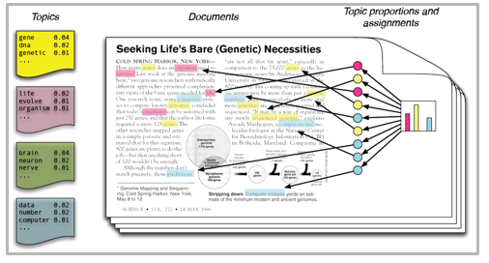
Classical representation

Slide 6
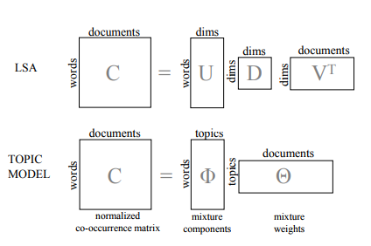
LSA vs LDA

Slide 7
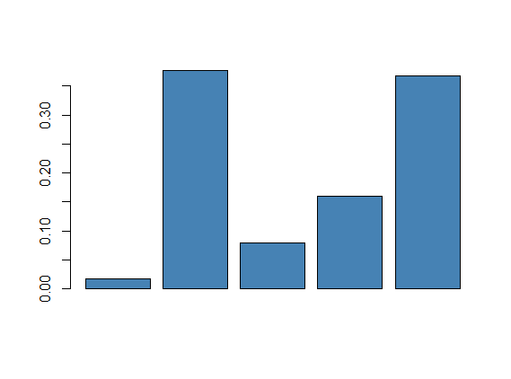
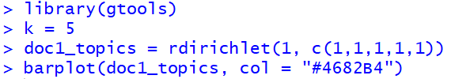
Prior Probability
First step in LDA is to decide upon number of topics (K)
For each document randomly assign topic mixtures which are sample from dirichlet distribution
Random mixtures of topics can be sampled using ‘rdirichlet’ function
We can specify number of times to sample (=no. of docs)
Following is an example of one such sample
T1
T2
T3
T4
T5
Random topic distribution in a single document

Slide 8
Gibbs sampling
Randomly assign each word in the document to one of the K topics
Random assignment gives both topic representations of all documents and word distributions of all the topics
Gibbs sampling is used to update the appropriate topics using multiple iterations
For each document (d) in the corpus
For each word (w) in the document (d)
Update the topic (t) by calculating the probability of word (w) given a topic and probability of topic given document (d)

Slide 9
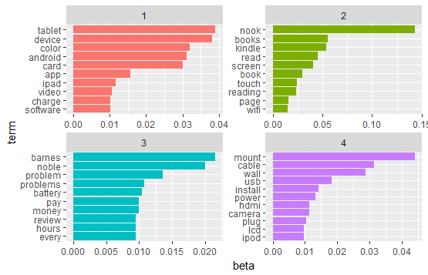
Top 10 words per topic
The first group contains words related to tablet (ipad, android, app, device etc). Hence we can label it as Tablets
The second group contains words related to e-reader (nook, kindly, books, touch, page etc). Hence we can label it as E-Reader
The third group contains words related to battery problems. We can name it as “Batteries”
The fourth group contain words related to wall mounting. We can name it as “Wall mounting”

